Slide 1


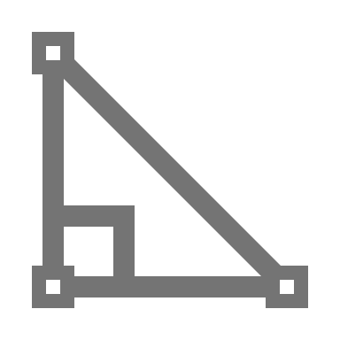

Where It's Used: many areas, such as building vehicles, power plants, and developing energy solutions.
Key Skills: Mechanical engineers use math and science to solve problems and design new things.
What It Is: Mechanical engineering involves making and testing machines that move.

Slide 2
What It Is: Mechanical engineering involves making and testing machines that move.
Key Skills: Mechanical engineers use math and science to solve problems and design new things.
Where It's Used: many areas, such as building vehicles, power plants, and developing energy solutions.

Slide 3
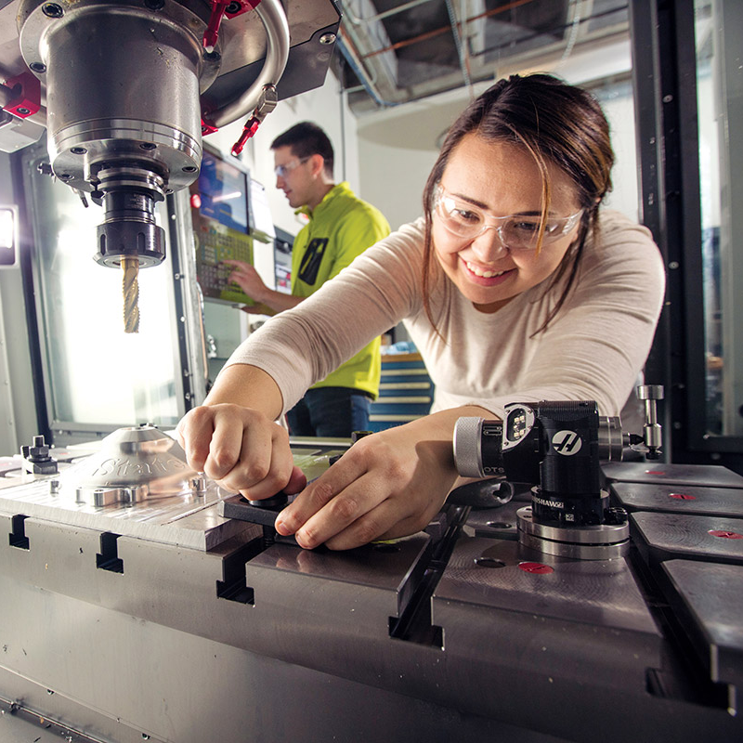
What It Is: Mechanical engineering involves making and testing machines that move.
Key Skills: Mechanical engineers use math and science to solve problems and design new things.
Where It's Used: many areas, such as building vehicles, power plants, and developing energy solutions.
Mechanical Engineering
What Do Mechanical Engineers Do?
Mechanical Engineers:
Design: machines and devices like cars, robots, and engines – all of which have moving parts.
Test: machines to see if they work well, then improve them to make them safer, faster, or more efficient.
Fix: mechanical problems and find ways to make things work better.

Slide 4
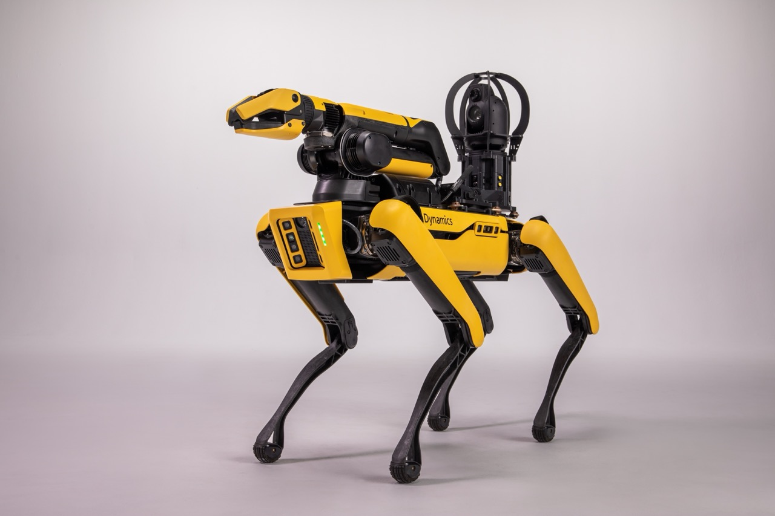

Mechanical Engineering
Mechanical Engineering
Fields
Robotics
Robotics engineers design and build robots and automated systems that can perform tasks in industries like manufacturing and healthcare.

Slide 5
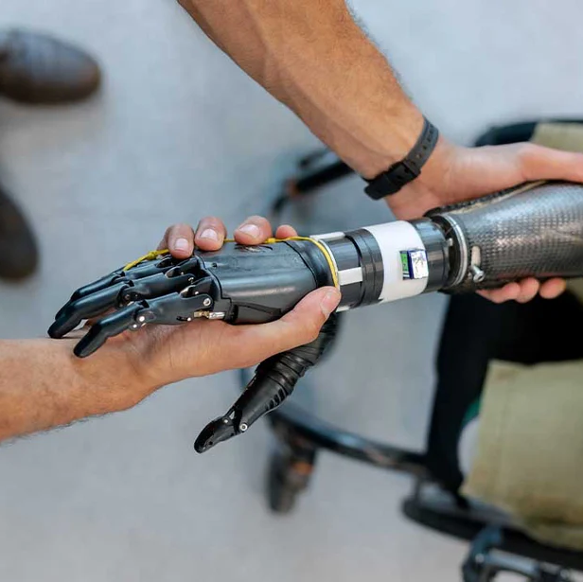
Mechanical Engineering
Mechanical Engineering
Fields
Automotive
Automotive engineers design, develop, and improve vehicles, including cars, trucks, and electric vehicles, focusing on efficiency, safety, and performance

Slide 6
Mechanical Engineering
Mechanical Engineering
Fields
HVAC
HVAC (Heating, Ventilation, and Air Conditioning) engineers create systems that regulate temperature and air quality in buildings to improve comfort and energy efficiency.

Slide 7
Mechanical Engineering
Mechanical Engineering
Fields
Biomechanics
Biomechanics engineers apply mechanical principles to the human body, developing prosthetics, medical devices, and equipment to enhance healthcare solutions.

Slide 8

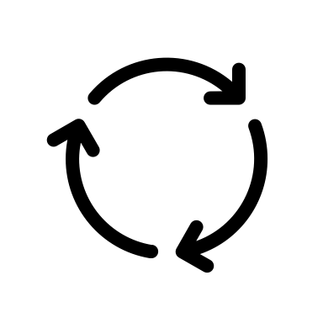



What It Is: Mechanical engineering involves making and testing machines that move.
Key Skills: Mechanical engineers use math and science to solve problems and design new things.
Where It's Used: many areas, such as building vehicles, power plants, and developing energy solutions.
Mechanical Engineering
Engineering Design Process
Define
The Problem
Improve
Brainstorm
Your Solution
Solutions
Mechanical engineers often use the engineering design process to solve problems
Test
Prototype
Your Prototype
Your Solution

Slide 9
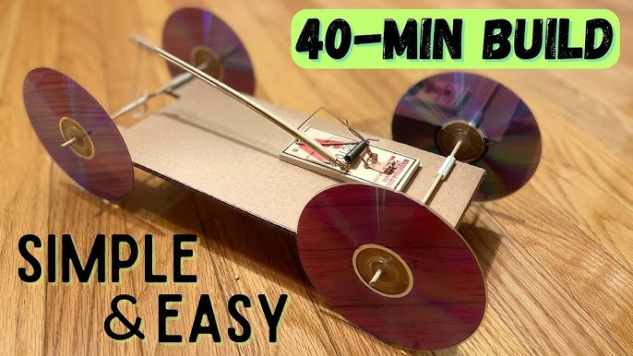
What It Is: Mechanical engineering involves making and testing machines that move.
Key Skills: Mechanical engineers use math and science to solve problems and design new things.
Where It's Used: many areas, such as building vehicles, power plants, and developing energy solutions.
Mechanical Engineering
Mousetrap Car
Project
Your goal is to build a car that is powered by a mousetrap, to get as close to a target as possible.
Materials:
Mousetrap
Cardboard
Dowels
Straw
Wheels
String
Final Product Example:

Slide 10
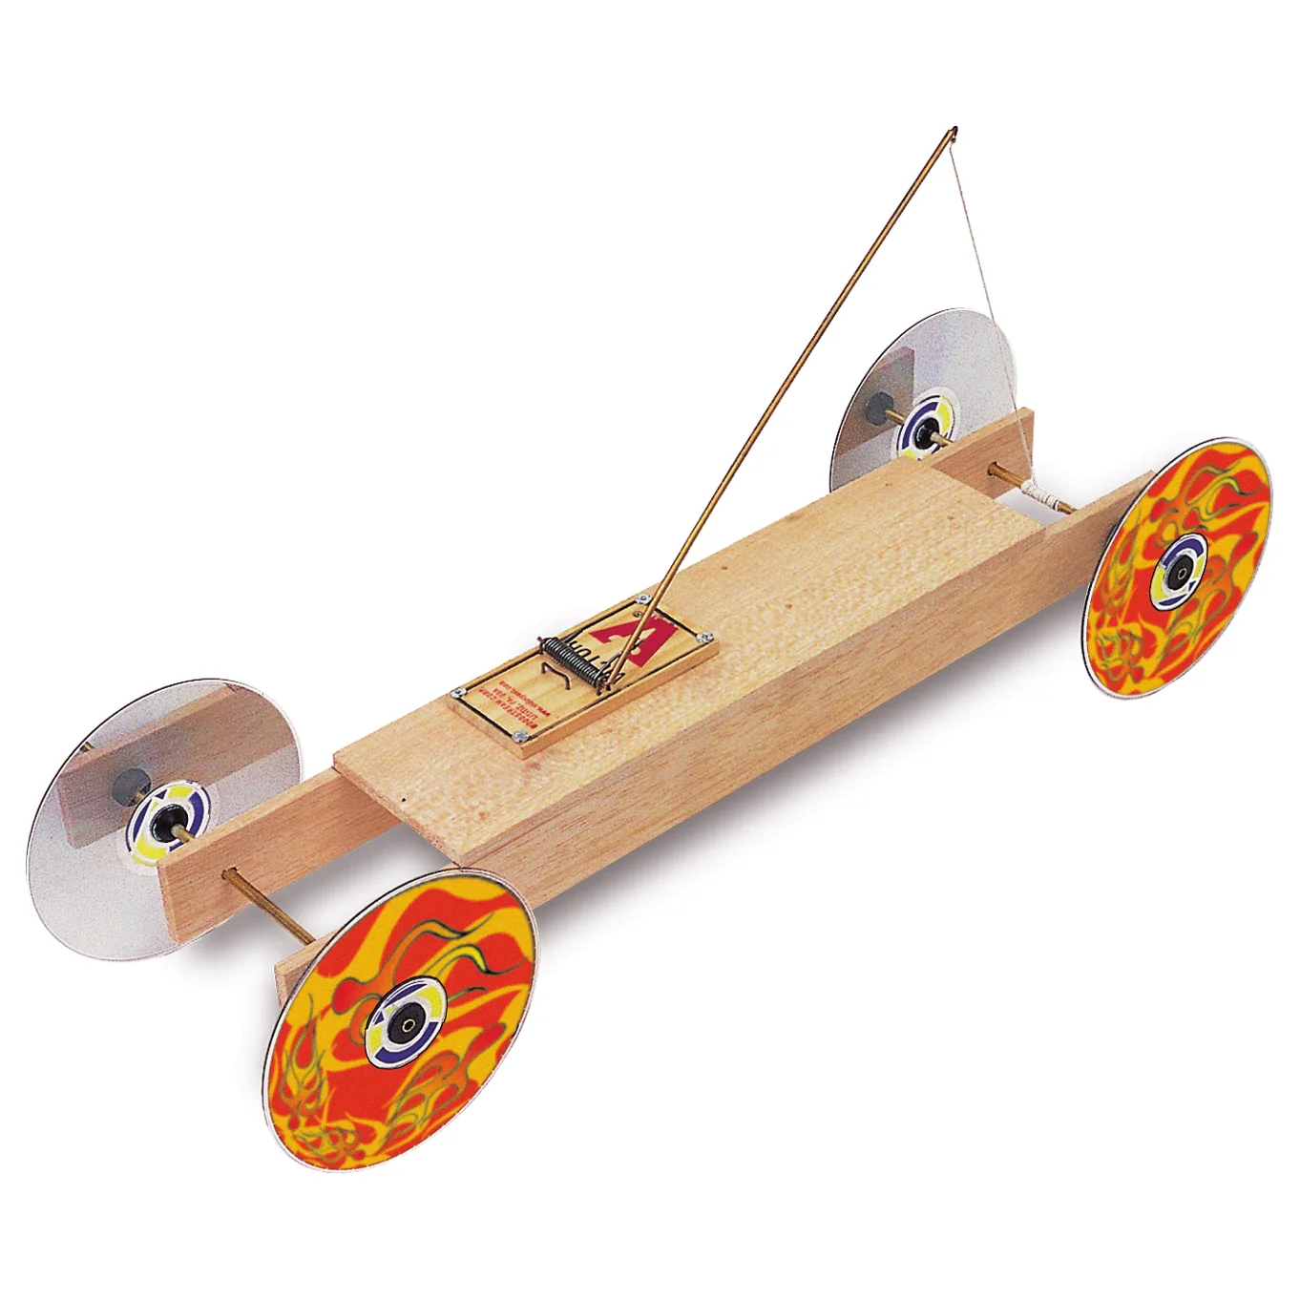

What It Is: Mechanical engineering involves making and testing machines that move.
Key Skills: Mechanical engineers use math and science to solve problems and design new things.
Where It's Used: many areas, such as building vehicles, power plants, and developing energy solutions.
Mechanical Engineering
Mousetrap Car
Design
Basic Design:
Attach a string to the mousetrap’s lever arm.
When the mousetrap is released, it pulls the string off the drive axle, causing the wheels to rotate.

Slide 11
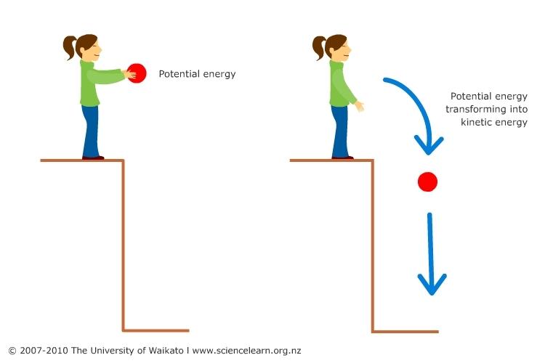
What It Is: Mechanical engineering involves making and testing machines that move.
Key Skills: Mechanical engineers use math and science to solve problems and design new things.
Where It's Used: many areas, such as building vehicles, power plants, and developing energy solutions.
Mechanical Engineering
Key Lesson: Potential and Kinetic Energy
You may be asking what makes the mouse trap car move
Potential Energy: When the mousetrap is set, energy is stored in the spring, creating potential energy.
Kinetic Energy: Once the mousetrap snaps, the stored energy is released and converted into kinetic energy, which moves the car.
Potential Energy: Is the energy stored in an object due to its position or condition. For example, a ball held at a height has gravitational potential energy because of its position above the ground.
Kinetic Energy: Is the energy of motion. An object in motion, such as a falling ball or a moving car, has kinetic energy.

Slide 12
What It Is: Mechanical engineering involves making and testing machines that move.
Key Skills: Mechanical engineers use math and science to solve problems and design new things.
Where It's Used: many areas, such as building vehicles, power plants, and developing energy solutions.
Mechanical Engineering
Key Lesson: Potential and Kinetic Energy
You may be asking what makes the mouse trap car move
Potential Energy: When the mousetrap is set, energy is stored in the spring, creating potential energy.
Kinetic Energy: Once the mousetrap snaps, the stored energy is released and converted into kinetic energy, which moves the car.
Potential Energy: Is the energy stored in an object due to its position or condition. For example, a ball held at a height has gravitational potential energy because of its position above the ground.
Kinetic Energy: Is the energy of motion. An object in motion, such as a falling ball or a moving car, has kinetic energy.

Slide 13
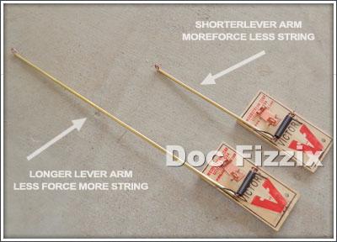
What It Is: Mechanical engineering involves making and testing machines that move.
Key Skills: Mechanical engineers use math and science to solve problems and design new things.
Where It's Used: many areas, such as building vehicles, power plants, and developing energy solutions.
Mechanical Engineering
Key Lesson: Factors Affecting Distance
Trying to make a mouse trap car go a certain distance (3m) can be rather difficult!
There are a lot of different ways to change how far your car goes
Friction: Check if hot glue is stopping your axle from spinning.
Wheel Diameter: Larger wheels will make the car go further with each rotation.
Length of Lever: Use a longer lever arm to increases the distance the string pulls the axle, allowing the car to travel further. Or use a shorter arm to decrease how far the car goes.

